Slide 1
Sorting & Hierarchy Flattening
Applied data structures and linear algebra

Slide 2
Scene Management
We will be discussing two distinct topics today, sorting and hierarchy flattening, both of which are steps in our scene management process.
Sorting - has to do with how we build, and sort, our containers of objects to be rendered this frame.
Hierarchy Flattening - This is how we use math to keep multiple meshes together, such as the wheels on a car.

Slide 3
Scene Management
Hierarchy Flattening
Hierarchy flattening is not a separate stage of scene management, instead it acts as a "lazy" or "just-in-time" process, happening only as the data is queried.
Get the viewable set - ED3 business
Sorting
Opaque Set
Transparent Set
RenderContext - This has been discussed previously
Render

Slide 4
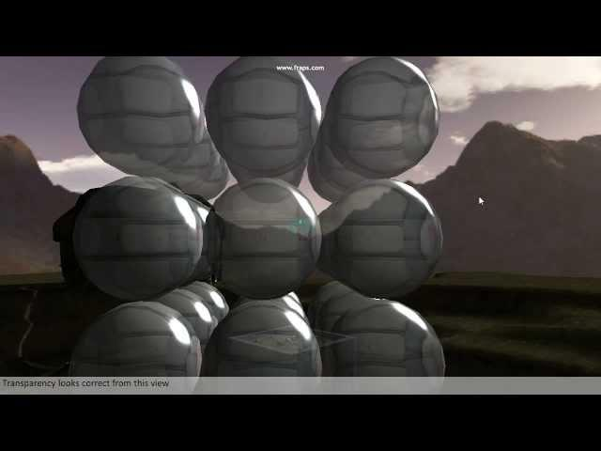
Transparent objects... incorrect

Slide 5

Transparent objects... correct

Slide 6
Transparency
Why can't we see the spheres behind other spheres at certain angles in the first video?
The first video had no sorting.
The second video showed transparency with sorting applied.
Sorting will be required to get transparent objects to blend properly.
...but why do we have to sort in order for blending to work?

Slide 7
Why sort the transparent set?
Data must be present to be blended with
Data must be present to be blended with!!!
Blending operations happen between source colors and destination colors, A.K.A. the color we are rendering and the color that is already present where we are rendering
This is the same reason we typically render transparent objects twice, once for the back faces, then the front faces, so the front faces can blend with the back faces.

Slide 8
What to sort by?
We want to render the object furthest in our view direction first.
Distance in view direction just means depth.
Depth and distance are not the same things.
Two objects could have the same distance and different depth, or same depths and different distances.
Sorting by distance will not give the same result and will likely result in undesired artifacts.

Slide 9
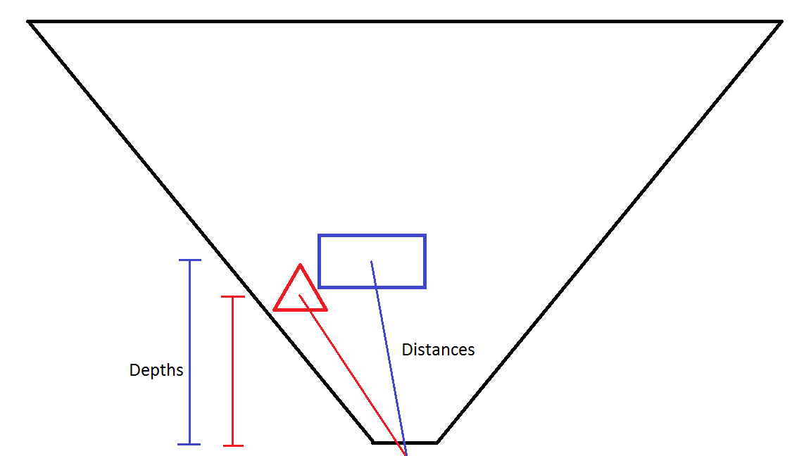
Depth Vs. Distance

Slide 10
Calculating Depth
In a vertex shader, we would calculate depth by transforming the position into view space, then the Z component would be the depth.
To "transform" we do a 4x4 matrix multiply, which is 16, 4 component, dot products, or...
Depth = (viewDirection dot toObjFromCamera) / (mag(viewDirection) * mag(toObjFromCamera));
We can ignore everything after the divide, if the vectors are unit length.

Slide 11
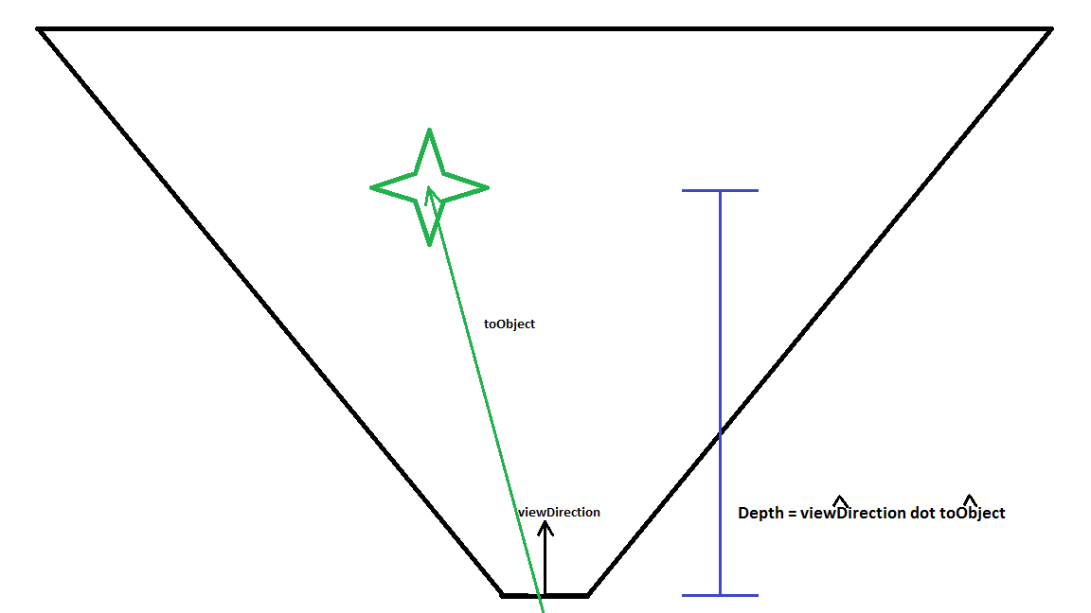
Calculating Depth

Slide 12
Sorting the Opaque Set
Sorting back to front is a requirement for transparency blending, it is not an optimization.
With this technique in mind, how can we sort our opaque set(s) to reduce rendering cost?
We can sort our opaque set from front to back, increasing the number of depth test fails, reducing the cost of overdraw.

Slide 13
Sorting the Opaque Set
Insert picture here of mostly occluded high-polygon object

Slide 14
Sorting the Opaque Set
Sorting the opaque set from front to back will not result in a frame rate boost if the sorting cost outweighs the benefit.
This is the case in our engine/scene, why?
Our scene is sparse with few objects typically being occluded.
Our deferred shading model only suffers from overdraw during the geometry stage, whose cost is much smaller without lighting calculations being done.

Slide 15
Scene Management
Hierarchy Flattening
Get the viewable set
Sorting
Opaque Set - Sort from smallest depth to largest, for possible optimization due to reduced cost of overdraw.
Transparent Set - Sort from largest depth to smallest as colors cannot be blended with colors that have not been rendered yet.
RenderContext - We sort by RenderContext to have fewer engine state changes. This is always an optimization.
Render

Slide 16
Hierarchy Flattening
We will need a system for attaching objects to each other.
Examples:
Attach a shoulder/arm mesh to a chest mesh of a character. We want the arm to be able to move on its own, while still being dragged along by the chest
We want to be able to make a character pick up an item in game, and have that item stay in their hand no matter where the hand goes.
Non-renderable items get attached as well such as the frustum to our camera or a trigger event zone on a moving platform.

Slide 17
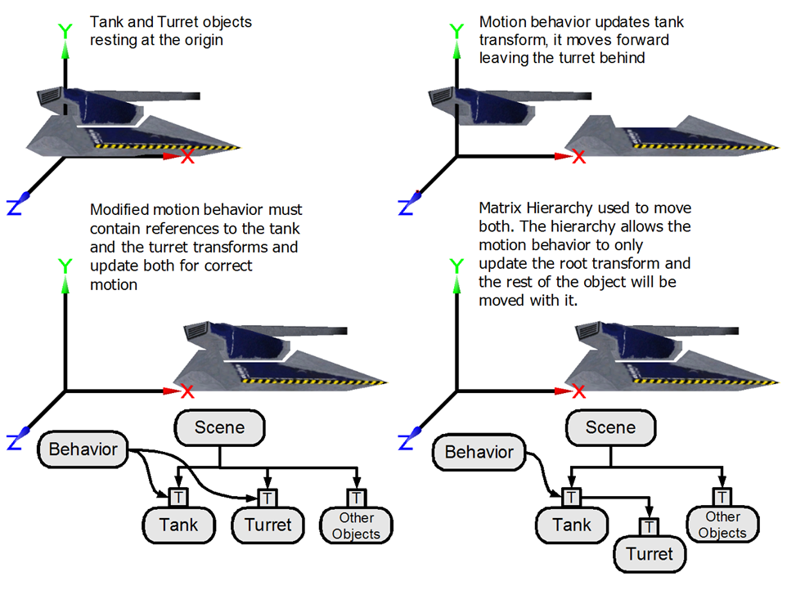
Hierarchy Flattening
1.
2.
3.
4.

Slide 18
Hierarchy Flattening
Simply applying the same behavior to all "grouped" objects will not give good results, consider a "rotate local Y" behavior applied to all the pieces of a player model.

Slide 19


Rotate on Local Y

Slide 20
Hierarchy Flattening
We want a system where we can apply behaviors to the root piece we intend to change alone, and have the child pieces stay attached.
An example would be, moving our tank (base) forward, and the turret and barrel going with the rest.
We will create this support in our TransformNode class, which all our game entities inherit from.

Slide 21
TransformNode
TransformNode
{
private:
Matrix world;
Matrix local;
};
const Matrix & GetWorld()
{
// a lot of space left to add code...
return world;
}
Our transform node will contain both a world and local matrix.
World - This is effectively read-only. We access it when we want to know where something is, but we do not apply behaviors to this matrix.
Local - This is the matrix we apply behaviors and transforms to. It represents where this object is with regards to its parent, not the world.

Slide 22
TransformNode
TransformNode
{
private:
Matrix world;
Matrix local;
TransformNode *parentPtr;
};
const Matrix & GetWorld()
{
if( !parentPtr )
world = local;
else
// other stuff...
return world;
}
We will need access to our parent's transform.
If we have no parent, our world matrix will be equal to our local matrix
Our tank base has no parent, but the turret has the tank base as a parent

Slide 23
TransformNode
TransformNode
{
private:
Matrix world;
Matrix local;
TransformNode *parentPtr;
};
const Matrix & GetWorld()
{
if( !parentPtr )
world = local;
else
world = local * parentPtr->GetWorld();
return world;
}
If we have a parent, our world matrix should be the combination of our local and our parent's flattened world matrix.
The "parentPtr->GetWorld()" would compile as "parentPtr->world" but this would not ensure we are using the flattened version.
Consider the case where the barrel matrix is a combination of the local barrel and turret world, where the turret also has a parent and could need flattening.

Slide 24
TransformNode
Row Major
0.707 | 0 | -0.707 | 0 |  | 1 | 0 | 0 | 0 |  | 0.707 | 0 | -0.707 | 0
0 | 1 | 0 | 0 |  | 0 | 1 | 0 | 0 |  | 0 | 1 | 0 | 0
0.707 | 0 | 0.707 | 0 |  | 0 | 0 | 1 | 0 |  | 0.707 | 0 | 0.707 | 0
0 | 0 | 0 | 1 |  | 0 | 0 | 2 | 1 |  | 0 | 0 | 2 | 1
X
=
Translation
Column Major
0.707 | 0 | 0.707 | 0 |  | 1 | 0 | 0 | 0 |  | 0.707 | 0 | 0.707 | 1.414
0 | 1 | 0 | 0 |  | 0 | 1 | 0 | 0 |  | 0 | 1 | 0 | 0
-0.707 | 0 | 0.707 | 0 |  | 0 | 0 | 1 | 2 |  | -0.707 | 0 | 0.707 | 1.414
0 | 0 | 0 | 1 |  | 0 | 0 | 0 | 1 |  | 0 | 0 | 0 | 1
X
=
Be mindful of the order of the multiply of local times parent's world. We will not get the same result between a row major system and a column major system.
If I move forward along the Z Axis, then turn my torso to the left 45 degrees, how much translation on the X should I have? Only what I started with.

Slide 25
TransformNode
TransformNode
{
private:
Matrix world;
Matrix local;
TransformNode *parentPtr;
};
const Matrix & GetWorld()
{
if( !parentPtr )
world = local;
else
world = local * parentPtr->GetWorld();
return world;
}
This method will work as is but is very wasteful. Consider what happens with the following:
float x = SomeTransformNode.GetWorld().WAxis.X;
float y = SomeTransformNode.GetWorld().WAxis.Y;
Both lines of code will invoke the hierarchy flattening process, even though the answer from the first line is still correct for the second!

Slide 26
TransformNode
TransformNode
{
private:
Matrix world;
Matrix local;
TransformNode *parentPtr;
bool bDirty;
};
const Matrix & GetWorld(){
if( bDirty){
if( !parentPtr )
world = local;
else
world = local * parentPtr->GetWorld();
bDirty = false;
}
return world;}
We will use a dirty flag to test if we need to flatten the hierarchy again, or if we can get away with returning the same world matrix we already have.
When we do calculate the world matrix, we can set the dirty flag to false, and if we are not dirty simply return world.
...And we have now broken everything...
When do we set the dirty flag to true again?

Slide 27
TransformNode
TransformNode
{
private:
Matrix world;
Matrix local;
TransformNode *parentPtr;
bool bDirty;
std::list<TransformNode *> children;
};
Matrix & GetLocal() {
MakeDirty();
return local;
}
Matrix & MakeDirty() {
bDirty = true;
Foreach child in children
child->MakeDirty();
}
Whenever a node is changed ( has a behavior applied) that node should be dirtied.
Whenever a node is changed its children should be dirtied.
When a node is changed we must dirty its children's children's children's children's children's children's children's children's children's children's children's children's children's...

Slide 28
Notes on bDirty
TransformNode does not have a bool called bDirty!
Instead it has a bit field, make sure you are comfortable with your bitwise operators before attempting this lab.
One of the reasons for the bit field is to store other states the system can use. One of these states is the inheritance model. As explained we get complete inheritance, translation, scale and orientation from our parent. You will need to add support for inheriting just the translation as well.

